Slide 1
Kibana panel介紹
2015/02/10

Slide 2
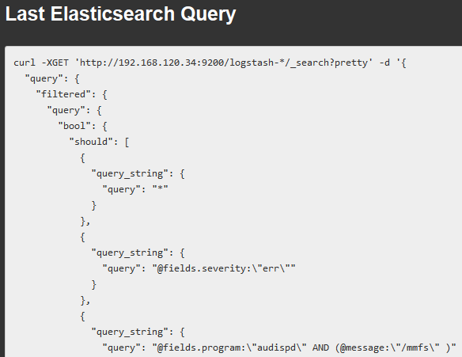
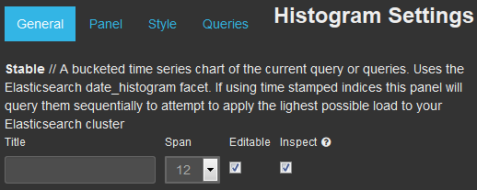
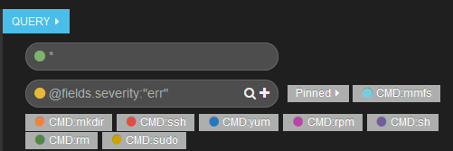


Panel Settings
General - 各個panel都有的屬性
Panels - 每個panel都有不同的屬性
Bettermap
Column
Histogram
Hits
Map
Sparklines
Stats
Table
Terms
Text
Trends
Style - 呈現的樣式(如顏色、直條圖、線性圖等)
Queries - 自定義Query條件
All、pinned、unpinned、selected
Panel寬度
Editable

Slide 3
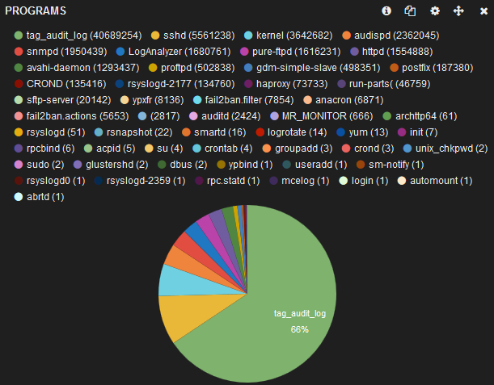
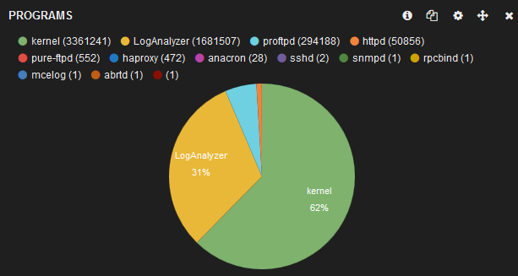
Queries
用途
過濾Source field value
某些panel以Query條件當作Source Value，而不是以Field作為Source Value
hits、histogram(count)、Trends、 Goal

Slide 4
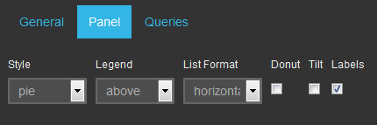
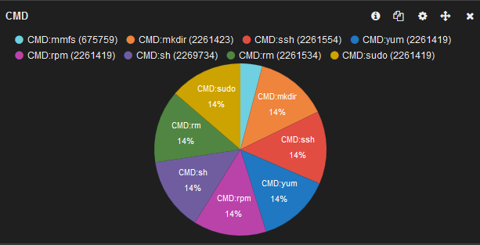
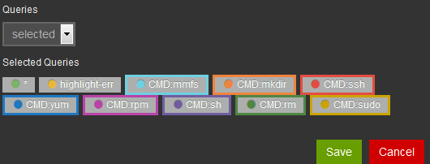
Panel -Hits
The hits panel displays the number of hits for each of the queries on the dashboard.
情境 - 統計指令出現次數
@fields.program:"audispd" AND (@message:"/mmfs" )

Slide 5
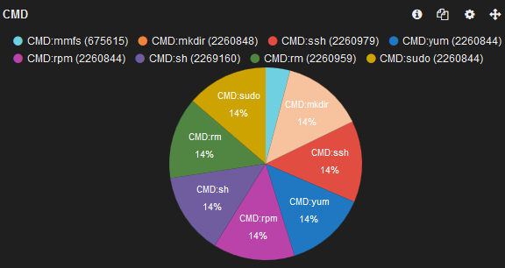
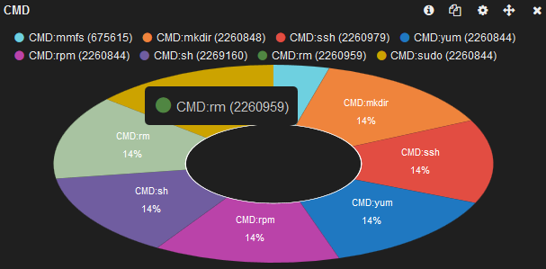


Hits - Style
PIE
PIE(donut、tlit)
List
total

Slide 6
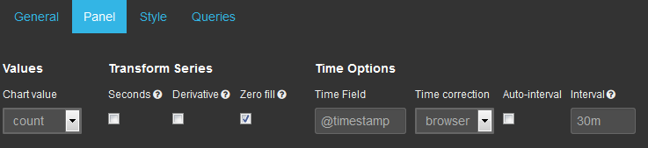
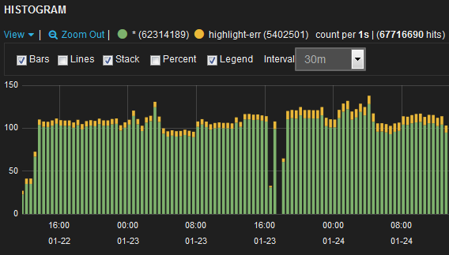
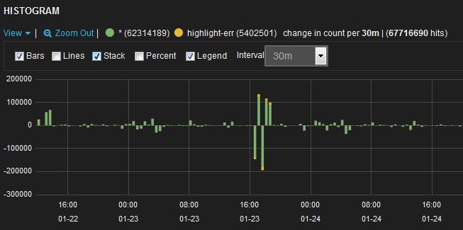
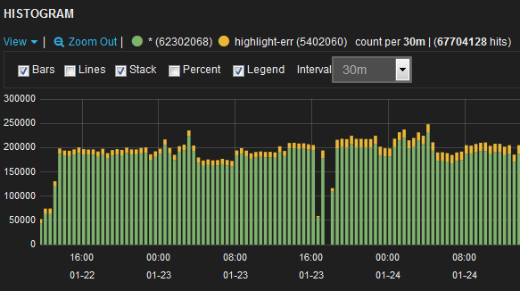
Panel-Histogram
The histogram panel allow for the display of time charts.
Browser, utc
與前一個interval相比增加減少的筆數
每條線為30分鐘內的總筆數
30分鐘內平均每秒鐘的筆數

Slide 7
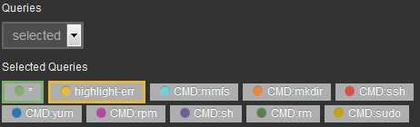

Panel-Histogram
Chart Value
以「Queries 」作為Source Value
count
以「Field」作為Source Value
min、mean、max、total
以Interval時間為基準 e.g. Interval = 30m
min : 取30分鐘內最小值
total : 將30分鐘內的所有值加總
chart value * scale = 圖表呈現的值
1000 * 4 = 4000

Slide 8
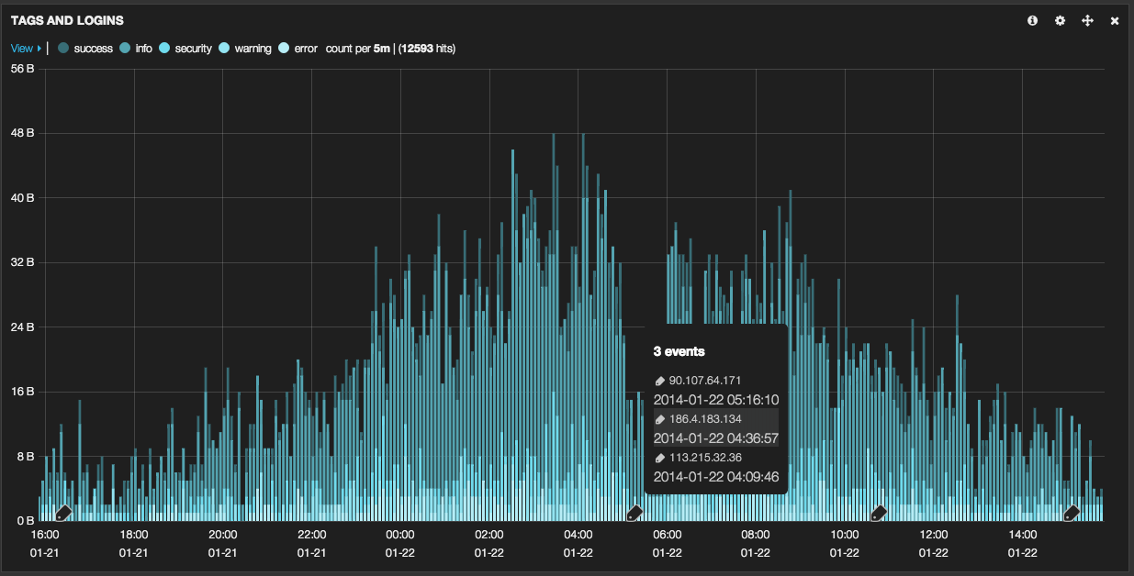
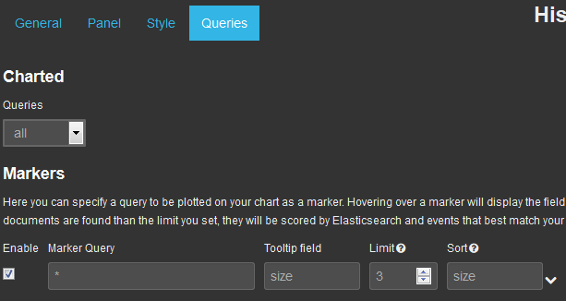
Histogram - chart makers
Chart markers let you input a custom query to be used to draw your important events inline with a time series chart.

Slide 9
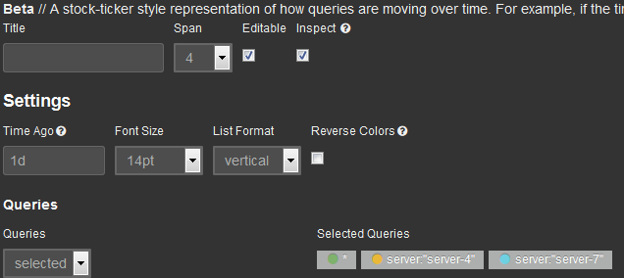
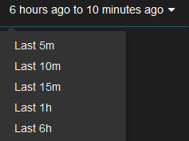

Panel - Trends
A stock-ticker style representation of how queries are moving over time.
Time Ago = 1h
NOW
05:00
05:10
06:00
06:10
顛倒顏色
Time Picker = 10m
比對兩段時間的變化百分比

Slide 10
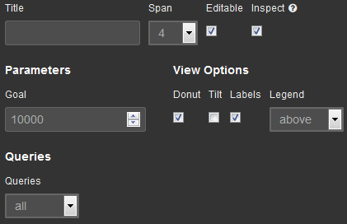
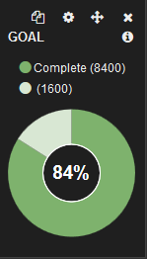
Panel - Goal
Displays the progress towards a fixed goal on a pie chart
目標值

Slide 11
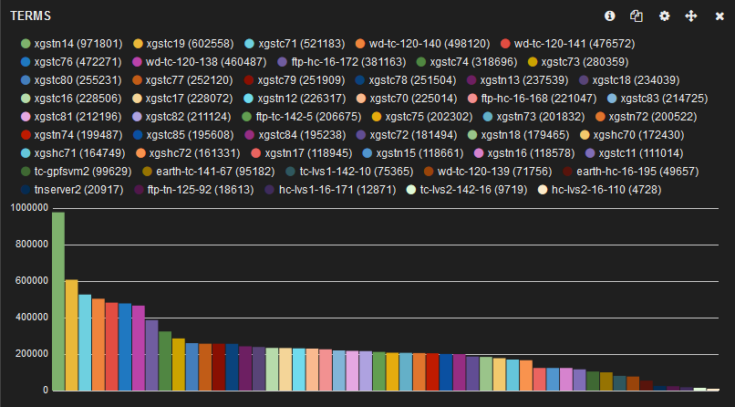
Panel - Terms
A table, bar chart or pie chart based on the results of an Elasticsearch terms facet.
適合應用
統計各個「字串」出現次數
e.g. 每台主機的log數量

Slide 12
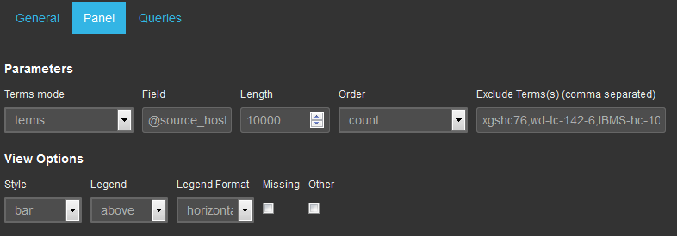
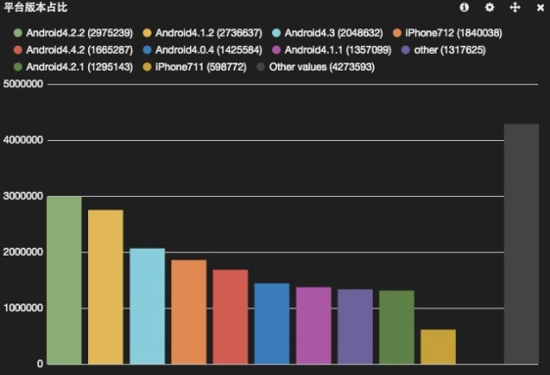
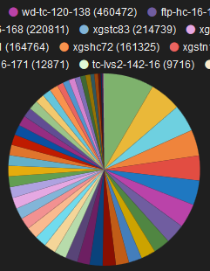
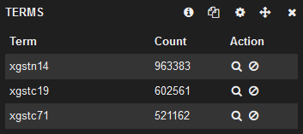
Panel - Terms
terms, terms_stats
要顯示的字串數
排除不顯示的字串
Source Value(String)
排序方式
「Queries」以外的值
統計空欄位值數量
Table
Bar
Pie

Slide 13
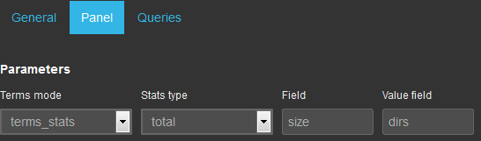
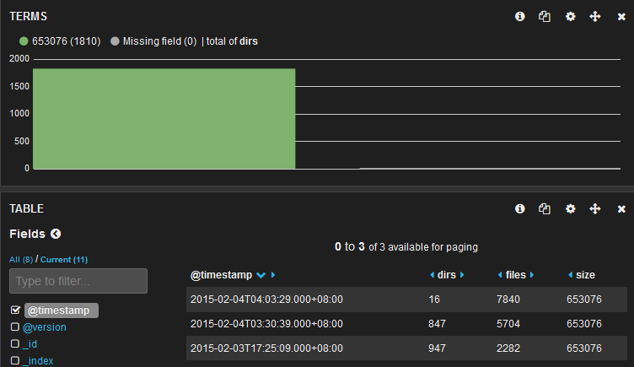
Panel - Terms
terms mode
terms : 統計同一個欄位各個值出現的次數
terms_stats : String與「數值」欄位比對
數值欄位統計方式
total, mean, min, max…
16+847+947=1810

Slide 14

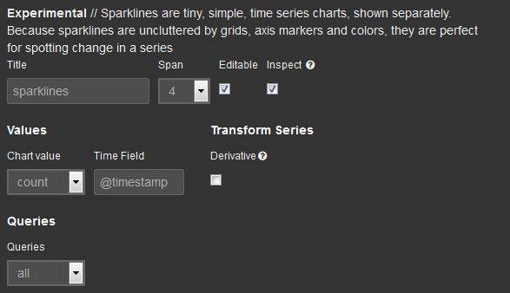
Panel - Sparklines
Sparklines are tiny, simple, time series charts, shown separately.
與histogram相同

Slide 15
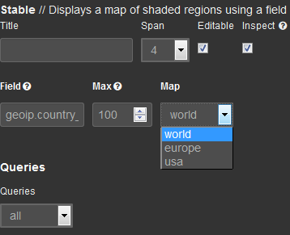
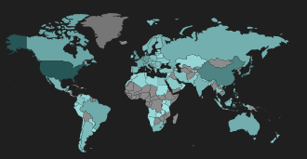
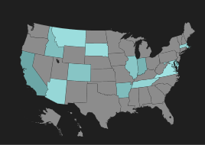
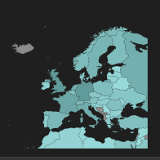
Panel - Map
Displays a map of shaded regions using a field containing a 2 letter country , or US state, code.
國碼(geoip.country_2)
如 TW,CN
world
usa
europe

Slide 16
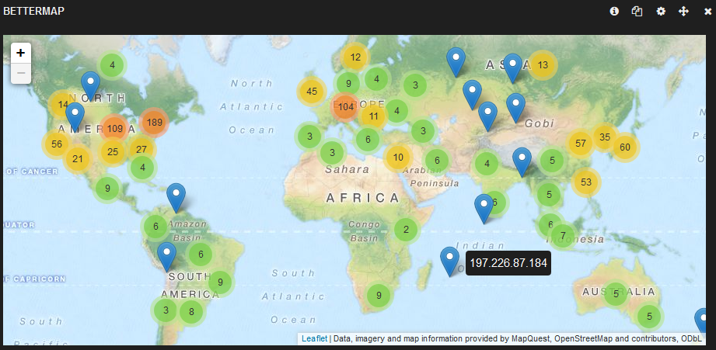
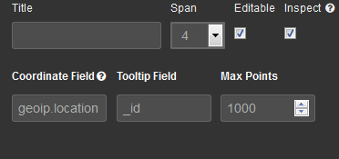
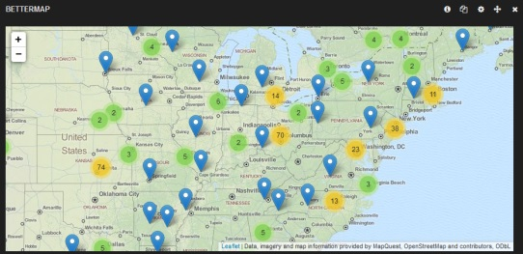
Panel - Bettermap
Displays geo points in clustered groups on a map.
經緯度(geoip.location)
如:4.5,51.91669999
用欄位值作為註解

Slide 17
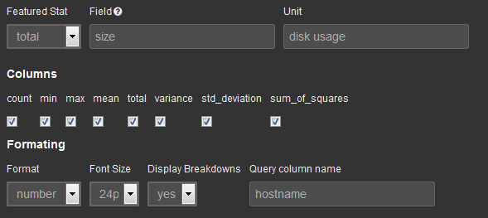
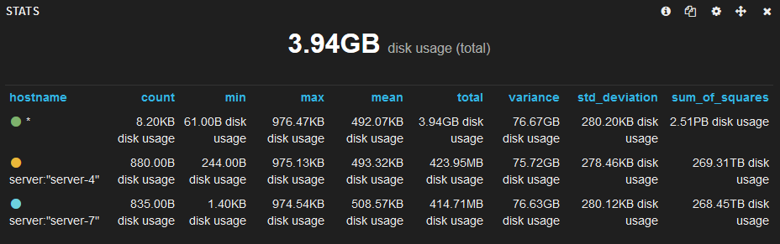
Panel - Stats
A statistical panel for displaying aggregations using the Elasticsearch query.
number
bytes
float
是否要顯示詳細資訊

Slide 18
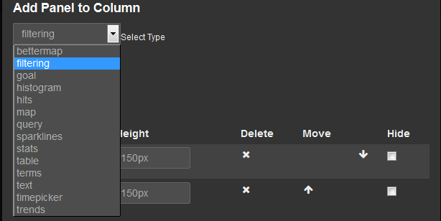
Panel - Column
A pseudo panel that lets you add other panels to be arranged in a column.
繼承 parent dashboard

Slide 19
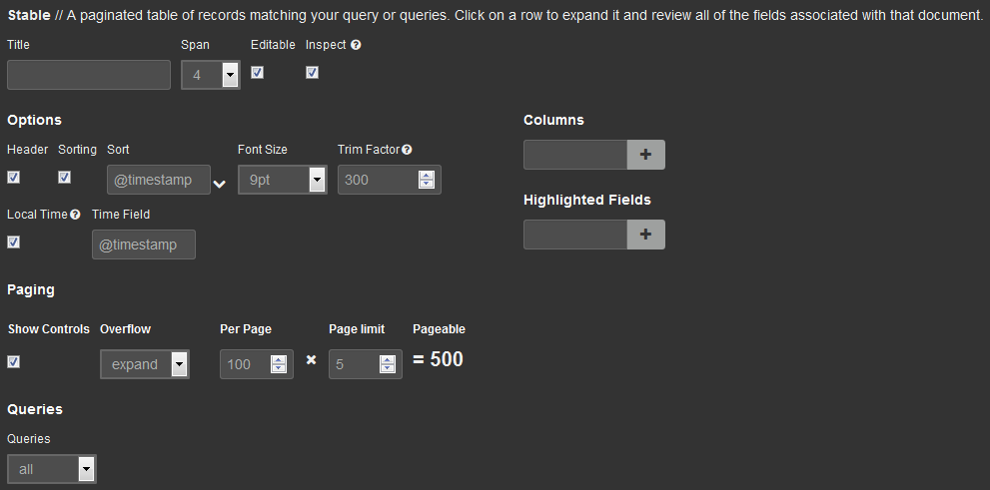
Panel - Table
A paginated table of records matching your query or queries.
table要顯示哪些欄位
欄位中符合Query條件的字串會被Highlight成紅字白底
Table要載入幾筆查詢結果

Slide 20
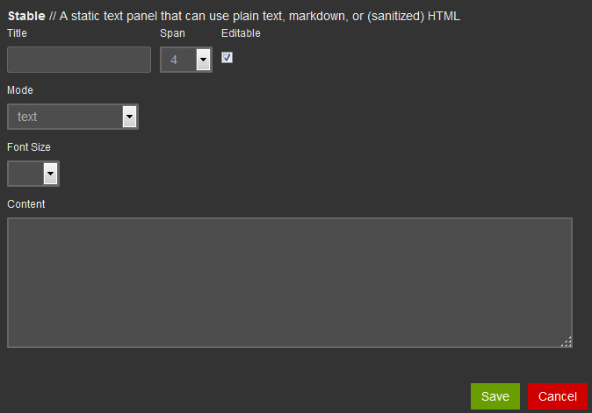
Panel - text
A static text panel that can use plain text, markdown, or (sanitized) HTML

Slide 21
Future works
Message queue
測試RabbitMQ
METRICS
Riemann tunning
LOG
Elasticsearch
elasticsearch-auth
+shield (30 day free trial)
Logstash
欄位加解密
Windows - 解決斷字
logstash-forwarder (Lumberjack)
Kibana
介紹各個panel
kibana-authentication-proxy

